Slide 1

Selected Topics in Computational Intelligence I
Session 8
Supervised Neural Networks

Slide 2
Agenda
Learning Feed Forward network
Backpropagation in MLP
Incremental Training
Deep Learning

Slide 3
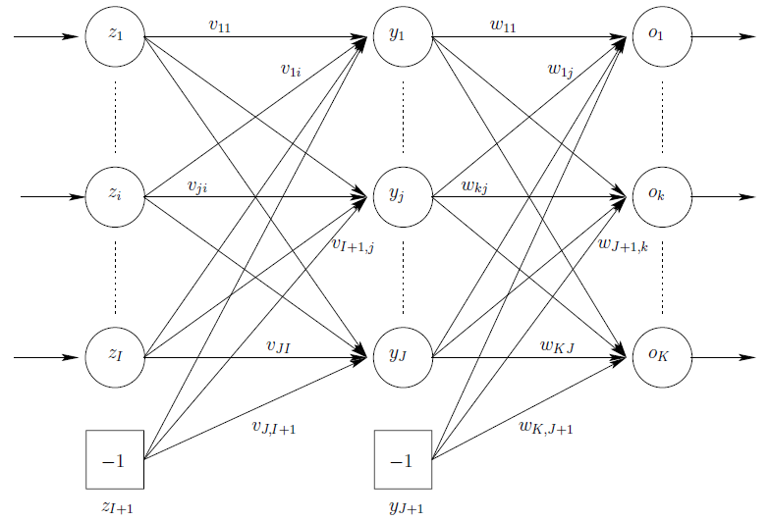
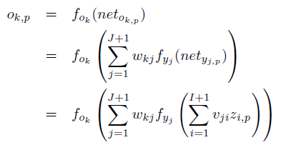
Feed Forward Neural Networks
FFNN consisting of three layers: an input layer (note that some literature on NNs do not count the input layer as a layer), a hidden layer and an output layer.
where f_{ok} and f_{yj} are respectively the activation function for output unit o_{k} and hidden unit y_{j}

Slide 4
Hidden layer
Number of Hidden layer | Result
None | Only capable of representing linear separable functions or decisions
1 | Can approximate any function that contains a continuous mapping from one finite space to another
2 | Can approximate any function that contains a continuous and smooth mapping from one finite space to another

Slide 5
Artificial Neuron Learning
There are three main types of learning:
Supervised learning, where the neuron (or NN) is provided with a data set consisting of input vectors and a target (desired output) associated with each input vector. The aim of supervised training is then to adjust the weight values such that the error between the real output, o = f(net−θ), of the neuron and the target output, t, is minimized.
Unsupervised learning, where the aim is to discover patterns or features in the input data with no assistance from an external source.
Reinforcement learning, where the aim is to reward the neuron (or parts of a NN) for good performance, and to penalize the neuron for bad performance.

Slide 6
Delta Rule
This learning method is called the delta rule, because of the way the perceptron checks its accuracy.
The difference between the perceptron's output and the correct output is assigned the Greek letter delta.
Change in Weight i = Current Value of Input i × (Desired Output - Current Output)

Slide 7
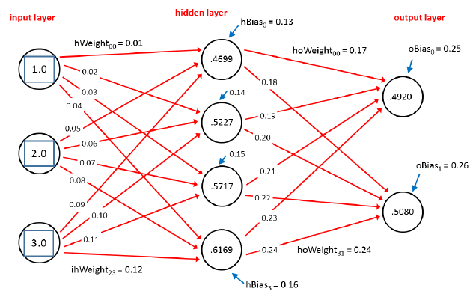
Example of Feed Forward
The basic neural network input-process-output computation is called the feed-forward mechanism.
Source : James McCaffrey (2014),
Neural Network using C# Succintly, Syncfusion Publisher.

Slide 8
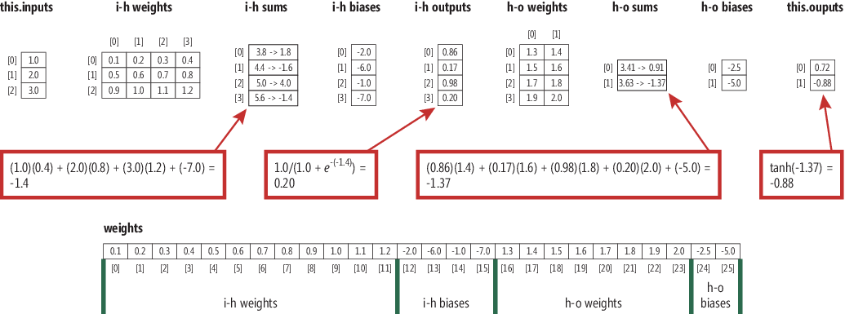
example

Slide 9
Feed forward
feed-forward mechanism is to compute the values shown in the hidden layer nodes.
First, the product of each input value and its associated weight are summed:
hSums[0] = (1.0)(0.01) + (2.0)(0.05) + (3.0)(0.09) = 0.01 + 0.10 + 0.27 = 0.38
Next, the associated bias value is added:
hSums[0] = 0.38 + 0.13 = 0.51

Slide 10
Feed forward
You can see this displayed as the first pre-activation sum. Next, a so-called activation function is applied to the sum.
Activation functions using hyperbolic tangent function tanh,
hOutputs[0] = tanh(0.51) = 0.4699
private static double HyperTan(double v) {
if (v < -20.0) return -1.0;
else if (v > 20.0) return 1.0;
else
return Math.Tanh(v);
}

Slide 11
Feed forward
The other three hidden nodes are computed in the same way. Here, the steps are combined to save space:
hOutputs[1] = tanh( (1.0)(0.02) + (2.0)(0.06) + (3.0)(0.10) + 0.14 ) = tanh(0.58) = 0.5227
hOutputs[2] = tanh( (1.0)(0.03) + (2.0)(0.07) + (3.0)(0.11) + 0.15 ) = tanh(0.65) = 0.5717
hOutputs[3] = tanh( (1.0)(0.04) + (2.0)(0.08) + (3.0)(0.12) + 0.16 ) = tanh(0.72) = 0.6169

Slide 12
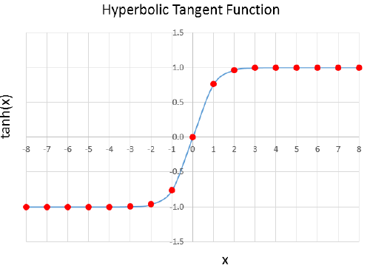
Hyperbolic Tanget Function

Slide 13
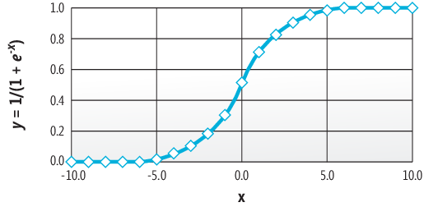
Activation function: sigmoid

Slide 14
sigmoid
private static double LogSigmoid(double x) {
if (x < -45.0) return 0.0;
else if (x > 45.0) return 1.0;
else
return 1.0 / (1.0 + Math.Exp(-x));
}

Slide 15
output
After all hidden node output values have been computed, these values are used as inputs to the output layer.
oSums[0] = (0.4699)(0.17) + (0.5227)(0.19) + (0.5717)(0.21) + (0.6169)(0.23) + 0.25 = 0.6911
oSums[1] = (0.4699)(0.18) + (0.5227)(0.20) + (0.5717)(0.22) + (0.6169)(0.24) + 0.26 = 0.7229
The activation function for the output layer is called the softmax function
output[0] = exp(0.6911) / (exp(0.6911) + exp(0.7229)) = 1.9959 / (1.9959 + 2.0604) = 0.4920
output[1] = exp(0.7229) / (exp(0.6911) + exp(0.7229)) = 2.0604 / (1.9959 + 2.0604) = 0.5080

Slide 16
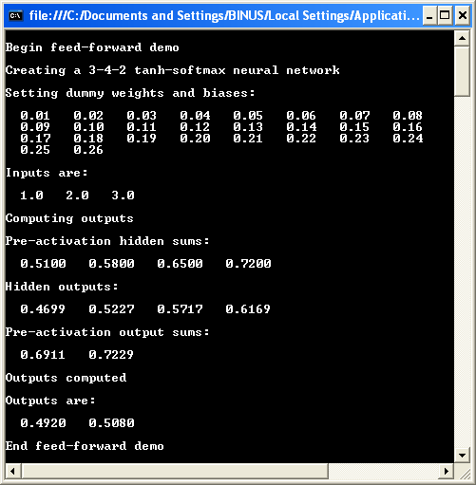
result

Slide 17
BackPropagation
Back-propagation compares neural network computed outputs (for a given set of inputs, and weights and bias values) with target values, determines the magnitude and direction of the difference between actual and target values, and then adjusts the neural network's weights and bias values so that the new outputs will be closer to the target values.
Pseudocode:
Loop until some exit condition
compute output values
compute gradients of output nodes
compute gradients of hidden layer nodes
update all weights and bias values
end
loop

Slide 18
Gradient
Gradients are values that reflect the difference between a neural network's computed output values and the desired target values.

Slide 19
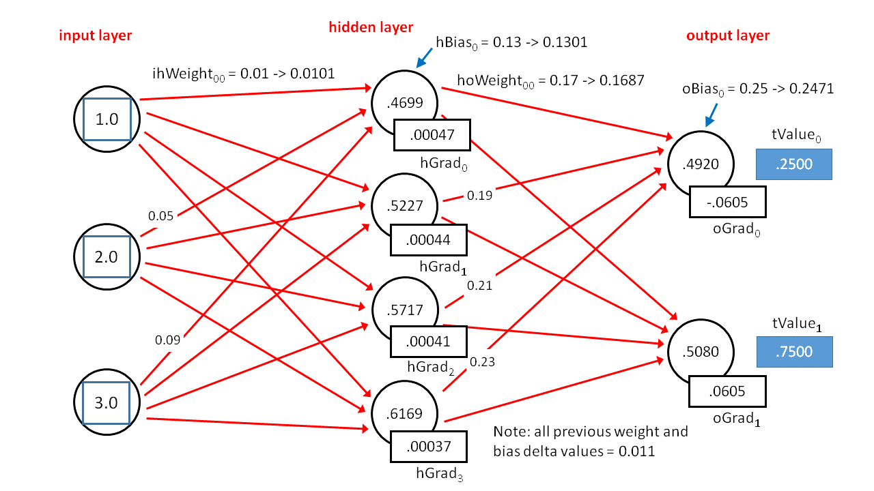
Gradient example

Slide 20
Gradient example
The gradient of an output node is the difference between the computed output value and the desired value, multiplied by the calculus derivative of the activation function used by the output layer.
The calculus derivative of the softmax activation function at some value y is just y(1 - y). The values of the output node gradients are calculated as:
oGrad[0] = (1 - 0.4920)(0.4920) * (0.2500 - 0.4920) = 0.2499 * -0.2420 = -0.0605
oGrad[1] = (1 - 0.5080)(0.5080) * (0.7500 - 0.5080) = 0.2499 * 0.2420 = 0.0605

Slide 21
Gradient example
double derivative = (1 - outputs[i]) * outputs[i];
// Derivative of softmax is y(1-y).
oGrads[i] = derivative * (tValues[i] - outputs[i]);

Slide 22
Gradient example
The calculation is best explained by example. As it turns out, the derivative of the hyperbolic tangent at some value y is (1 - y)(1 + y). The gradient for hidden node 0, with rounding, is computed as:
hGrad[0]:
derivative = (1 - 0.4699)(1 + 0.4699) = 0.5301 * 1.4699 = 0.7792
sum = (-0.0605)(0.17) + (0.0605)(0.18) = -0.0103 + 0.0109 = 0.0006
hGrad[0] = 0.7792 * 0.0006 = 0.00047 (rounded)

Slide 23
Gradient example
Similarly, the gradient for hidden node 1 is:
hGrad[1]:
derivative = (1 - 0.5227)(1 + 0.5227) = 0.4773 * 1.5227 = 0.7268
sum = (-0.0605)(0.19) + (0.0605)(0.20) = -0.0115 + 0.0121 = 0.0006
hGrad[3] = 0.7268 * 0.0006 = 0.00044

Slide 24
Gradient example
After all hidden node and output node gradient values have been computed, these values are used to compute a small delta value (which can be positive or negative) for each weight and bias.
The delta value is added to the old weight or bias value.
The new weights and bias values will, in theory, produce computed output values that are closer to the desired target output values.

Slide 25
Gradient example
Updating the weight from input node 0 to hidden node 0 is:
new ihWeight[0][0]:
delta = 0.05 * 0.00047 * 1.0 = 0.000025 I
hWeight[0][0] = 0.01 + 0.000025 = 0.010025
mFactor = 0.01 * 0.011 = 0.00011 ihWeight[0][0] = 0.010025 + 0.00011 = 0.0101
The delta is 0.05 (the learning rate) times 0.00047 (the downstream gradient) times 1.0 (the upstream input). This delta, 0.000025, is added to the old weight value, 0.01, to give an updated weight value.

Slide 26
Gradient example
The momentum factor is 0.01 (the momentum term) times 0.011 (the previous delta). In the demo program, all previous delta values are arbitrarily set to 0.011 to initialize the algorithm.
The computation of the new bias value for hidden node 0 is:
new hBias[0]:
delta = 0.05 * 0.00047 = 0.000025
hBias[0] = 0.13 + 0.000025 = 0.130025
mFactor = 0.01 * 0.011 = 0.00011
hBias[0] = 0.130025 + 0.00011 = 0.1301

Slide 27
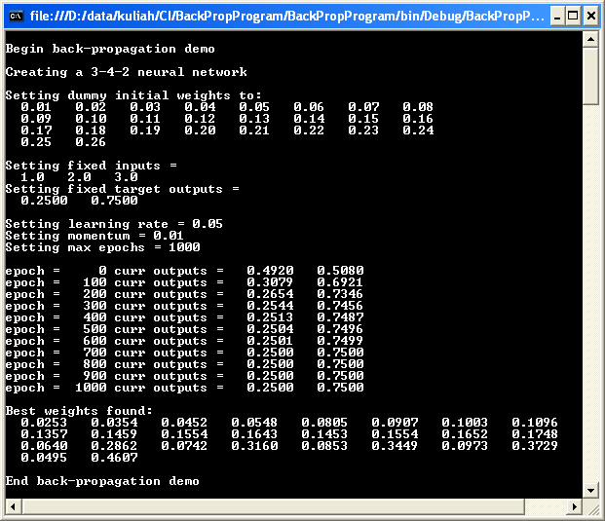
Result

Slide 28
Training
The ultimate goal of a neural network is to make a prediction. In order to make a prediction, a neural network must first be trained.
Training a neural network is the process of finding a set of good weights and bias values so that the known outputs of some training data match the outputs computed using the weights and bias values.

Slide 29
Batch Training
loop until done
for each training item
compute error and accumulate total error
end for
use total error to update weights and bias values
end loop
The essence of batch training is that an error metric for the entire training set is computed and then that single error value is used to update all the neural network's weights and biases.

Slide 30
Incremental Training
loop until done
for each training item
compute error for current item
use item's error to update weights and bias values
end for
end loop
some research evidence suggests that incremental training (also called online training) often gives better results (meaning it produces a model that predicts better) than batch training.

Slide 31
example
The demo takes the 150-item data set and splits it randomly into a 120-item subset (80%) to be used for training and a 30-item subset (20%) to be used for testing, that is, to be used to estimate the probability of a correct classification on data that has not been seen before.
The demo trains a 4-7-2 fully connected neural network using the back-propagation algorithm in conjunction with a technique that is called incremental training.

Slide 32
Example (con’t)
After training has completed, the accuracy of the resulting model is computed on the training set and on the test set. The model correctly predicts 97.50% of the training items (117 out of 120) and 96.67% of the test items (29 out of 30).
Therefore, if presented with data for a new iris flower that was not part of the training or test data, you could estimate that the model would correctly classify the flower with roughly a 0.9667 probability.

Slide 33
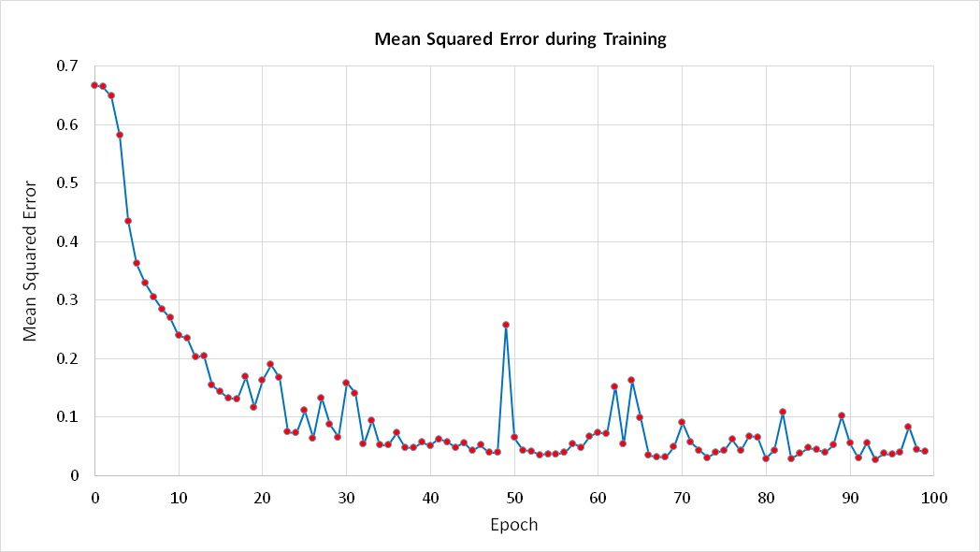
Mean Squared Error
The technique used by the demo is to use a moderate number for the hard-stop loop exit combined with the mean squared error (MSE).

Slide 34
Max Epochs
The heart of method Train is a while loop that has two exit conditions. The first is a hard limit based on the maxEpochs value. The second exit condition is a small error threshold based on the mean squared error of the current model over the entire training set.
double[] xValues = new double[numInput]; // Inputs.
double[] tValues = new double[numOutput]; // Target values.
…
while (epoch < maxEpochs)
{
double mse = MeanSquaredError(trainData);
if (mse < 0.040) break;

Slide 35
Data
double[][] allData = new double[150][];
allData[0] = new double[] { 5.1, 3.5, 1.4, 0.2, 0, 0, 1 };
allData[1] = new double[] { 4.9, 3.0, 1.4, 0.2, 0, 0, 1 }; // Iris setosa = 0 0 1
allData[2] = new double[] { 4.7, 3.2, 1.3, 0.2, 0, 0, 1 }; // Iris versicolor = 0 1 0
allData[50] = new double[] { 7.0, 3.2, 4.7, 1.4, 0, 1, 0 };
allData[51] = new double[] { 6.4, 3.2, 4.5, 1.5, 0, 1, 0 };
allData[52] = new double[] { 6.9, 3.1, 4.9, 1.5, 0, 1, 0 };

Slide 36
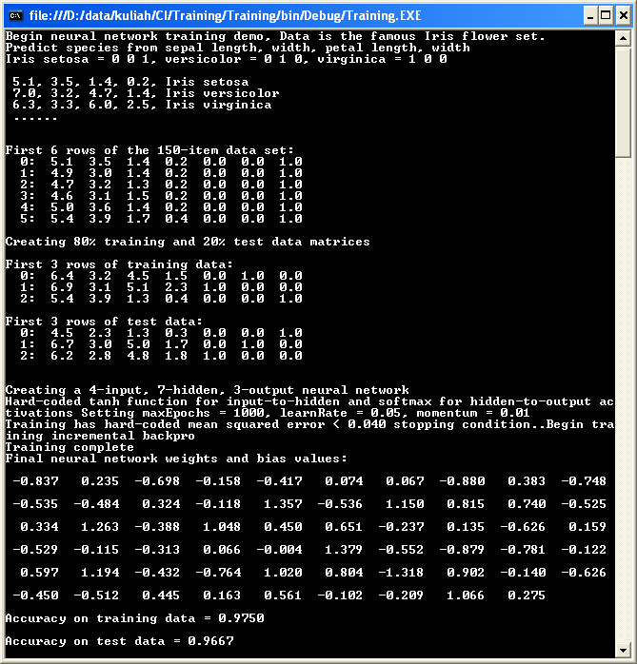
Result

Slide 37
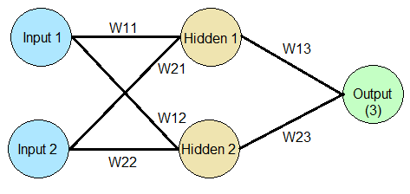
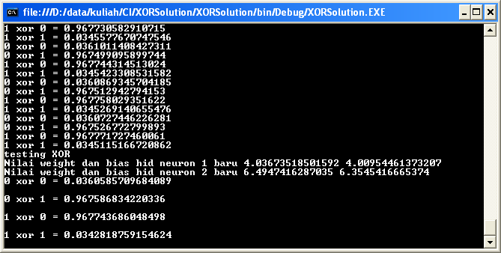
Exercise
Write a program for XOR using MLP, and analyze some aspects such as number of hidden nodes, epoch etc

Slide 38
Deep Learning
Deep Learning is a new area of Machine Learning research, which has been introduced with the objective of moving Machine Learning closer to one of its original goals: Artificial Intelligence.
Deep Learning is about learning multiple levels of representation and abstraction that help to make sense of data such as images, sound, and text.

Slide 39
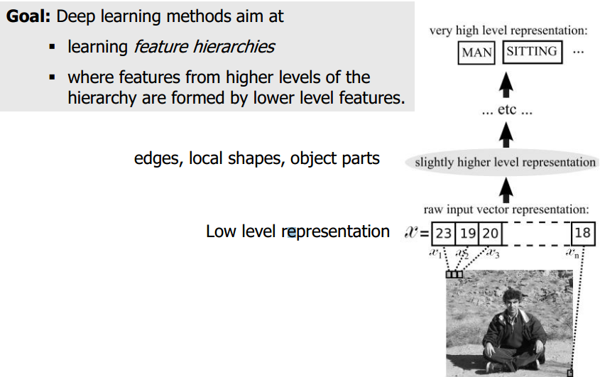
Deep Learning (con’t)

Slide 40
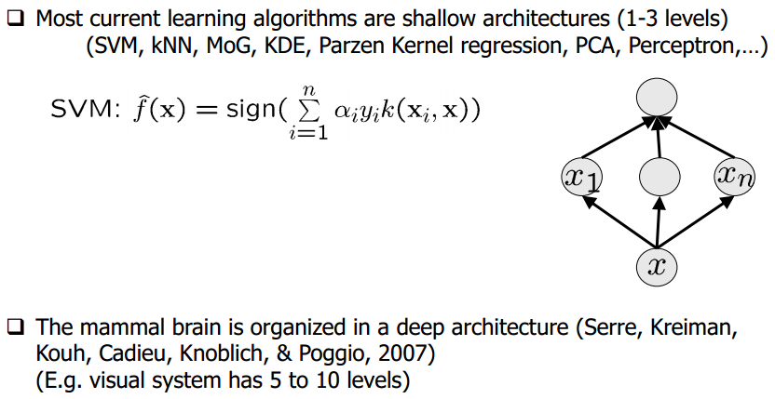
Why Deep Learning

Slide 41
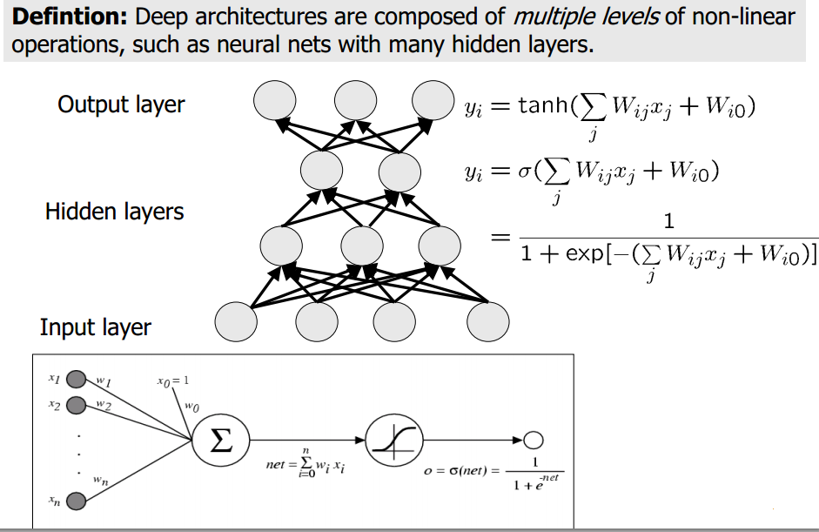
Deep Architectures

Slide 42
Theano
Theano is a python library that makes writing deep learning models easy, and gives the option of training them on a GPU.
The purely supervised learning algorithms are meant to be read in order:
1. Logistic Regression - using Theano for something simple
2. Multilayer perceptron - introduction to layers
3. Deep Convolutional Network - a simplified version of LeNet5

Slide 43
Logistic regression
Logistic regression is a probabilistic, linear classifier. It is parametrized by a weight matrix W and a bias vector b. Classification is done by projecting an input vector onto a set of hyperplanes, each of which corresponds to a class. The distance from the input to a hyperplane reflects the probability that the input is a member of the corresponding class.

Slide 44
The unsupervised algorithms can be read in any order
Auto Encoders, Denoising Autoencoders - description of autoencoders
Stacked Denoising Auto-Encoders - easy steps into unsupervised pre-training for deep nets
Restricted Boltzmann Machines (RBM) - single layer generative RBM model
Deep Belief Networks - unsupervised generative pre-training of stacked RBMs followed by supervised fine-tuning

Slide 45
Deep Learning
Deep learning algorithms are based on distributed representations, a concept used in machine learning. The underlying assumption behind distributed representations is that observed data is generated by the interactions of many different factors on different levels.

Slide 46
Deep Belief network
A deep belief network (DBN) is a probabilistic, generative model made up of multiple layers of hidden units. It can be looked at as a composition of simple learning modules that make up each layer

Slide 47
Exercise
Please run example of Deep Learning (MLP) using THEANO
You need Phyton and libraries
http://deeplearning.net/tutorial/deeplearning.pdf

Slide 48
References
Adries P. Engelbrect. (2007), Computational Intelligence An Introduction. 2nd ed. John Wiley & Sons. USA.
James McCaffrey (2014), Neural Network using C# Succintly, Syncfusion Publisher.
www.Deeplearning.net

Slide 49
Thank You

